Slide 1
Normalization of RGB hand dataset RHD

Slide 2
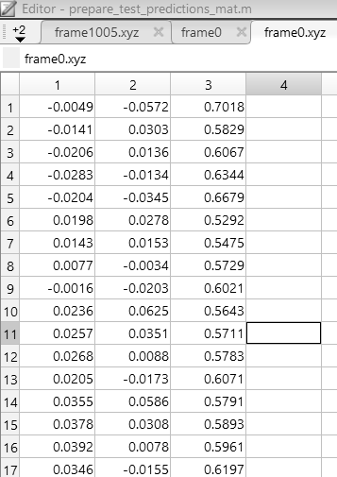
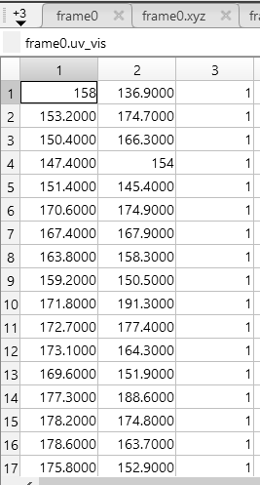
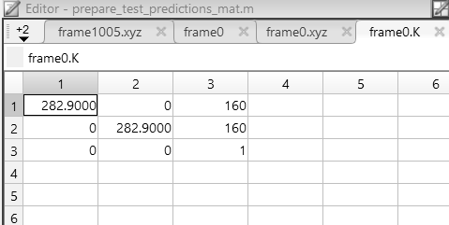

Overview of dataset
Dataset split 1. Train: 41258 2. Test: 2728
Each image is composed of 1. Left hand (21 joints)
2. Right hand (21 joints)
Ground Truth Annotation 1. 3D (unit: probably $m$?) 2. Camera Parameters 3. 2D projection 4. Visible mask

Slide 3
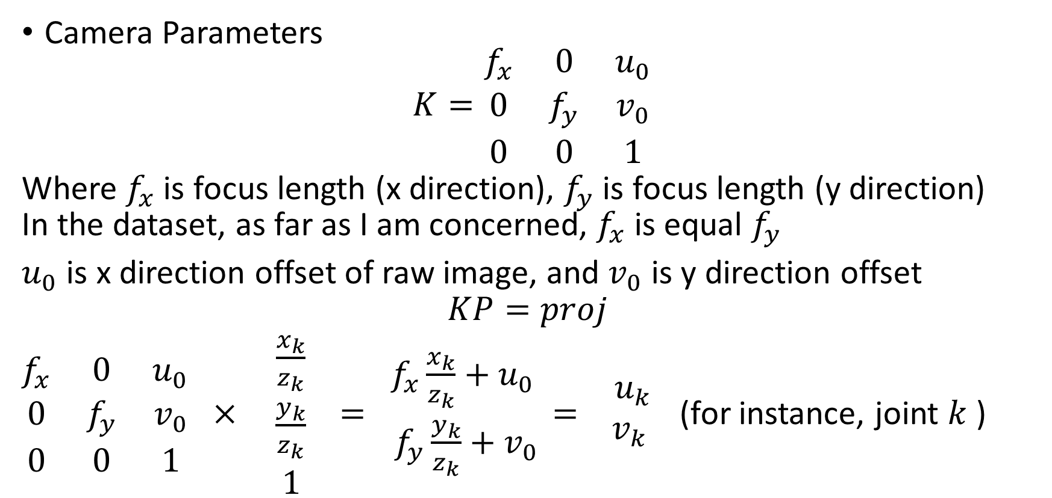
Overview of dataset
Camera Parameters
$$K=\begin{matrix}f_{x} & 0 & u_{0} \\ 0 & f_{y} & v_{0} \\ 0 & 0 & 1\end{matrix}$$
Where $f_{x}$ is focus length (x direction), $f_{y}$ is focus length (y direction) In the dataset, as far as I am concerned, $f_{x}$ is equal $f_{y}$
$u_{0}$ is x direction offset of raw image, and $v_{0}$ is y direction offset
$$KP=proj$$ $\begin{matrix}f_{x} & 0 & u_{0} \\ 0 & f_{y} & v_{0} \\ 0 & 0 & 1\end{matrix} × \begin{matrix}\frac{x_{k}}{z_{k}} \\ \frac{y_{k}}{z_{k}} \\ 1\end{matrix} = \begin{matrix}f_{x}\frac{x_{k}}{z_{k}}+u_{0} \\ f_{y}\frac{y_{k}}{z_{k}}+v_{0}\end{matrix}= \begin{matrix}u_{k} \\ v_{k} \end{matrix}$ (for instance, joint $k$ )

Slide 4
Hand Pose Estimation via Latent 2.5D Heatmap Regression
https://arxiv.org/pdf/1804.09534.pdf

Slide 5
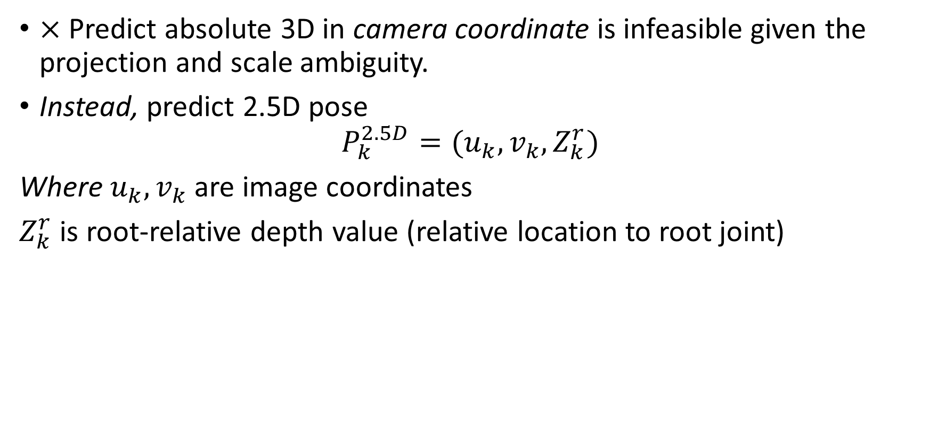
2.5D Pose Representation
$×$ Predict absolute 3D in camera coordinate is infeasible given the projection and scale ambiguity.
Instead, predict 2.5D pose
$$P_{k}^{2.5D}=(u_{k},v_{k},Z_{k}^{r})$$
Where $u_{k}, v_{k}$ are image coordinates
$Z_{k}^{r}$ is root-relative depth value (relative location to root joint)

Slide 6
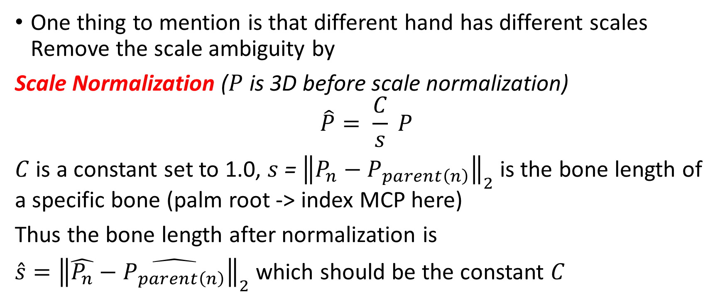
2.5D Pose Representation
One thing to mention is that different hand has different scales Remove the scale ambiguity by
Scale Normalization ($P$ is 3D before scale normalization)
$$\hat{P}= \frac{C}{s} P$$
$C$ is a constant set to 1.0, $s$ = ${\left\|P_{n}−P_{parent\left(n\right)}\right\|}_{2}$ is the bone length of a specific bone (palm root -> index MCP here)
Thus the bone length after normalization is
$\hat{s}={\left\|\hat{P_{n}}−\hat{P_{parent\left(n\right)}}\right\|}_{2}$ which should be the constant $C$

Slide 7
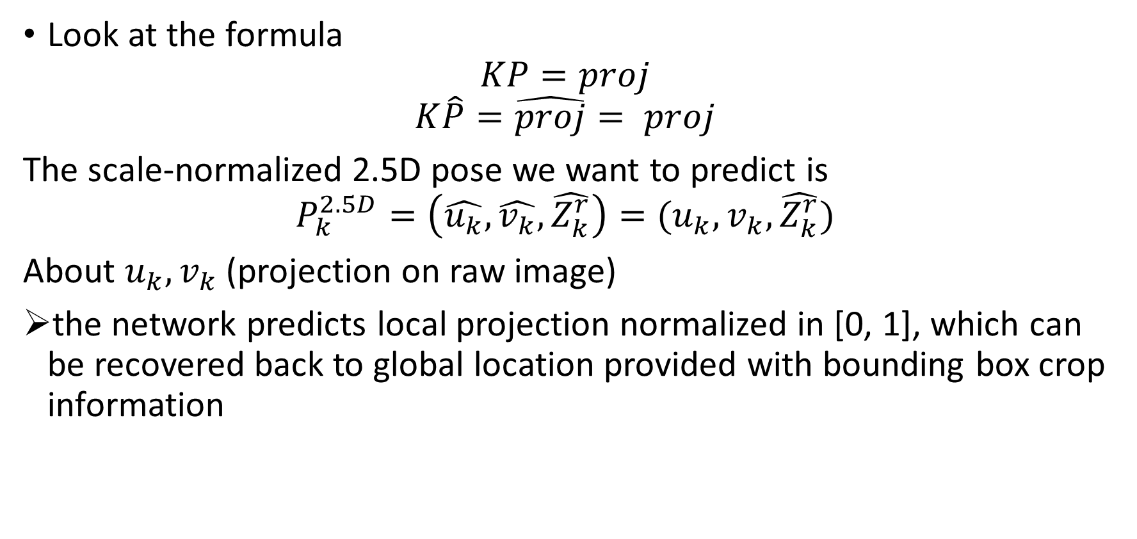
2.5D Pose Representation
Look at the formula
$$KP=proj$$
$$K\hat{P}=\hat{proj}= proj$$
The scale-normalized 2.5D pose we want to predict is
$$P_{k}^{2.5D}=\left(\hat{u_{k}},\hat{v_{k}},\hat{Z_{k}^{r}}\right)=(u_{k},v_{k},\hat{Z_{k}^{r}})$$
About $u_{k},v_{k}$ (projection on raw image)
the network predicts local projection normalized in [0, 1], which can be recovered back to global location provided with bounding box crop information

Slide 8
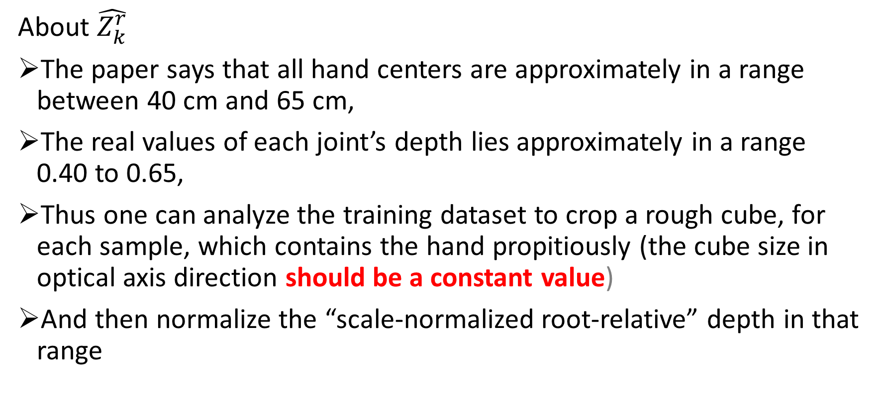
2.5D Pose Representation
About $\hat{Z_{k}^{r}}$
The paper says that all hand centers are approximately in a range between 40 cm and 65 cm,
The real values of each joint’s depth lies approximately in a range 0.40 to 0.65,
Thus one can analyze the training dataset to crop a rough cube, for each sample, which contains the hand propitiously (the cube size in optical axis direction should be a constant value)
And then normalize the “scale-normalized root-relative” depth in that range

Slide 9
Overall Architecture
Infer 2.5D from CNN
Scale normalized root Z
Scale recovery
Scale-normalized root-relative joint prediction get
Depth value of scale-normalized root $\hat{z_{root}}$ get
Depth value of scale-normalized root (𝑧_𝑟𝑜𝑜𝑡 ) ̂ get
Recover the scale-normalized absolute joint prediction to absolute w/o scale norm.

Slide 10
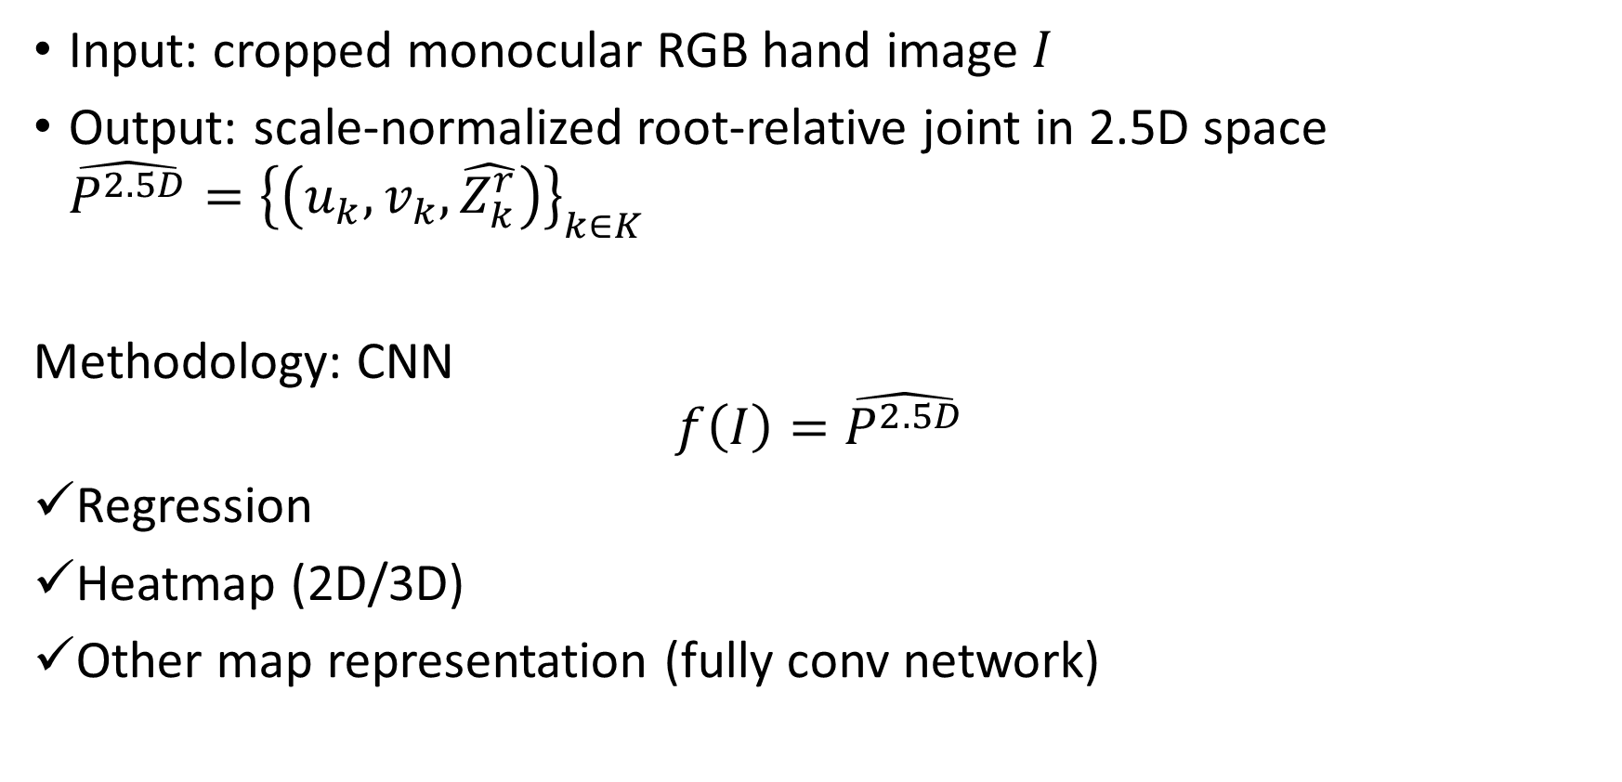
Scale-normalized root-relative joint
Input: cropped monocular RGB hand image $I$
Output: scale-normalized root-relative joint in 2.5D space $\hat{P^{2.5D}}{=\left\{\left(u_{k},v_{k},\hat{Z_{k}^{r}}\right)\right\}}_{k∈K}$
Methodology: CNN $$f\left(I\right)=\hat{P^{2.5D}}$$
Regression
Heatmap (2D/3D)
Other map representation (fully conv network)

Slide 11
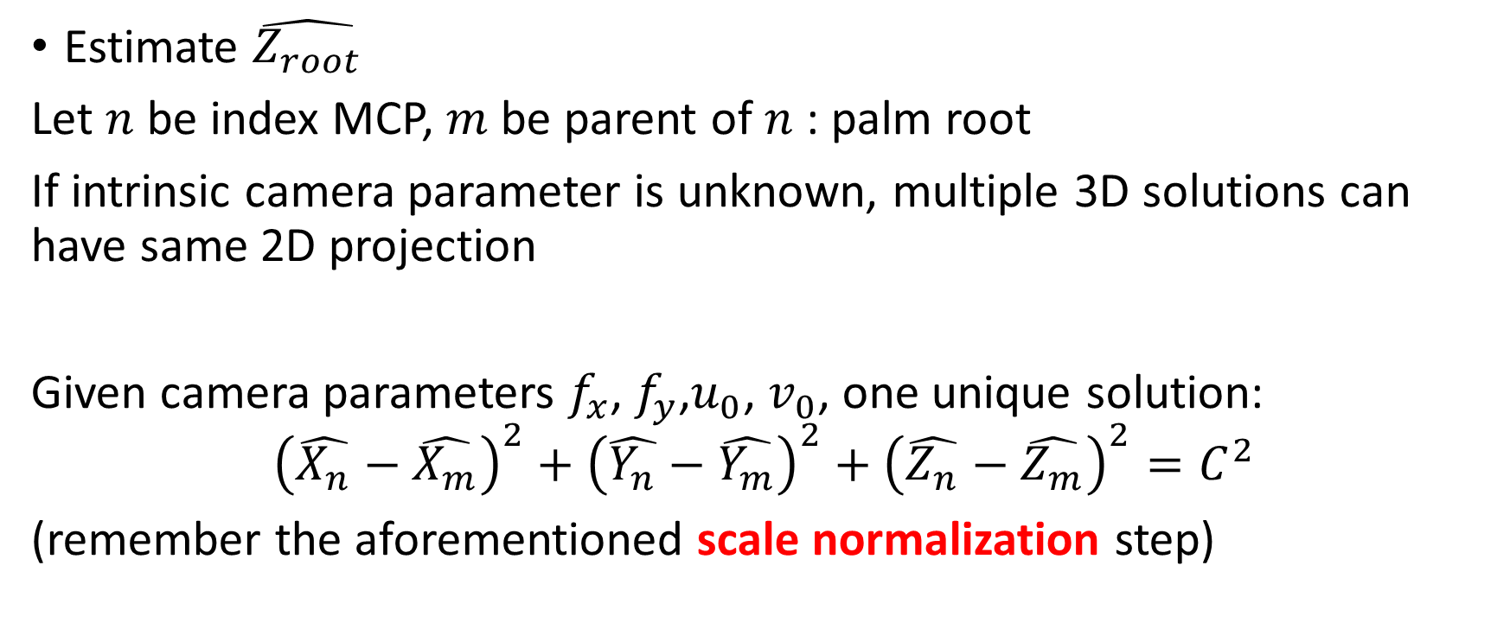
Scale-normalized depth value of root
Estimate $\hat{Z_{root}}$
Let $n$ be index MCP, $m$ be parent of $n$ : palm root
If intrinsic camera parameter is unknown, multiple 3D solutions can have same 2D projection
Given camera parameters $f_{x}$, $f_{y}$,$u_{0}$, $v_{0}$, one unique solution:
$${\left(\hat{X_{n}}−\hat{X_{m}}\right)}^{2}+{\left(\hat{Y_{n}}−\hat{Y_{m}}\right)}^{2}+{\left(\hat{Z_{n}}−\hat{Z_{m}}\right)}^{2}=C^{2}$$ (remember the aforementioned scale normalization step)

Slide 12

Scale-normalized depth value of root
$\begin{matrix}f_{x} & 0 & u_{0} \\ 0 & f_{y} & v_{0} \\ 0 & 0 & 1\end{matrix} × \begin{matrix}\frac{x_{k}}{z_{k}} \\ \frac{y_{k}}{z_{k}} \\ 1\end{matrix} = \begin{matrix}f_{x}\frac{x_{k}}{z_{k}}+u_{0} \\ f_{y}\frac{y_{k}}{z_{k}}+v_{0}\end{matrix}= \begin{matrix}u_{k} \\ v_{k} \end{matrix}$
$\hat{x_{n}}=\frac{(u_{n}−u_{0})\hat{Z_{n}^{r}}}{f_{x}}$, $\hat{x_{m}}=\frac{(u_{m}−u_{0})\hat{Z_{m}^{r}}}{f_{x}}$, $\hat{y_{n}}=\frac{(v_{n}−v_{0})\hat{Z_{n}^{r}}}{f_{y}}$, $\hat{y_{m}}=\frac{(v_{m}−v_{0})\hat{Z_{m}^{r}}}{f_{y}}$
Let $\hat{z_{root}}=t$

Slide 13




Scale-normalized depth value of root
${\left(\frac{u_{n}−u_{0}}{f_{x}}\left(t+\hat{z_{n}^{r}}\right)−\frac{u_{m}−u_{0}}{f_{x}}\left(t+\hat{z_{m}^{r}}\right)\right)}^{2}+$
${\left(\frac{v_{n}−v_{0}}{f_{y}}\left(t+\hat{z_{n}^{r}}\right)−\frac{v_{m}−v_{0}}{f_{y}}\left(t+\hat{z_{m}^{r}}\right)\right)}^{2}$+
${\left(\left(t+\hat{z_{n}^{r}}\right)−\left(t+\hat{z_{m}^{r}}\right)\right)}^{2}−C^{2}=0$
Which means
$${\left(\hat{X_{n}}−\hat{X_{m}}\right)}^{2}$$
$${\left(\hat{Y_{n}}−\hat{Y_{m}}\right)}^{2}$$
$${\left(\hat{Z_{n}}−\hat{Z_{m}}\right)}^{2}−C^{2}$$

Slide 14

Scale-normalized depth value of root
${\left(\left(\frac{u_{n}−u_{m}}{f_{x}}\right)t+\frac{u_{n}−u_{0}}{f_{x}}\hat{z_{n}^{r}}−\frac{u_{m}−u_{0}}{f_{x}}\hat{z_{m}^{r}}\right)}^{2}+$
${\left(\left(\frac{v_{n}−v_{m}}{f_{y}}\right)t+\frac{v_{n}−v_{0}}{f_{y}}\hat{z_{n}^{r}}−\frac{v_{m}−v_{0}}{f_{y}}\hat{z_{m}^{r}}\right)}^{2}$+
${\left(\hat{Z_{n}^{r}}−\hat{Z_{m}^{r}}\right)}^{2}−C^{2}=0$
To quadratic formula

Slide 15
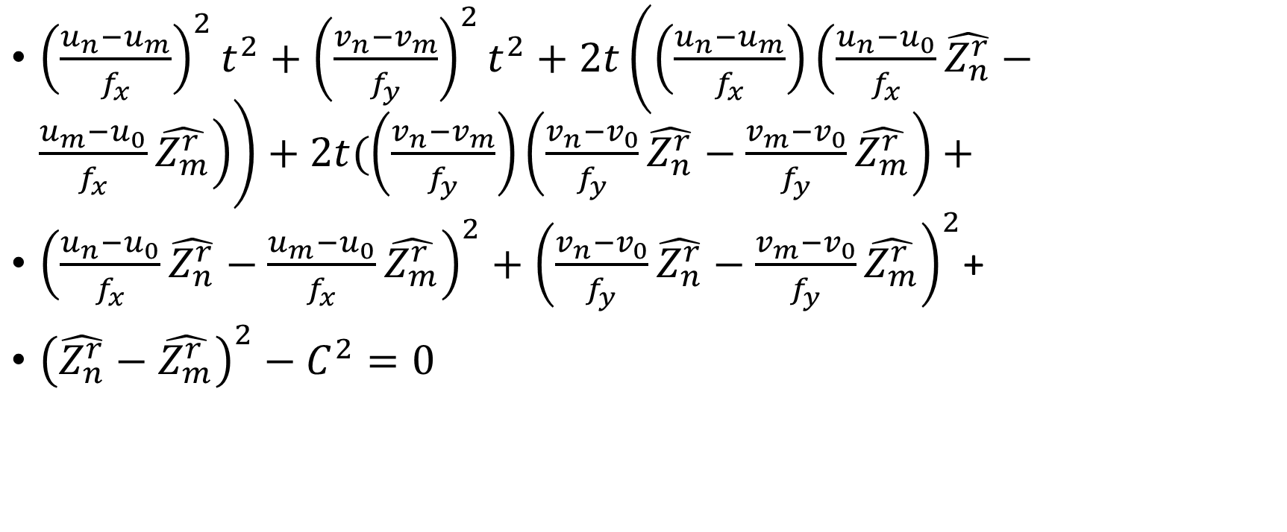
Scale-normalized depth value of root
${\left(\frac{u_{n}−u_{m}}{f_{x}}\right)}^{2}t^{2}+{\left(\frac{v_{n}−v_{m}}{f_{y}}\right)}^{2}t^{2}+2t\left(\left(\frac{u_{n}−u_{m}}{f_{x}}\right)\left(\frac{u_{n}−u_{0}}{f_{x}}\hat{Z_{n}^{r}}−\frac{u_{m}−u_{0}}{f_{x}}\hat{Z_{m}^{r}}\right)\right)+2t(\left(\frac{v_{n}−v_{m}}{f_{y}}\right)\left(\frac{v_{n}−v_{0}}{f_{y}}\hat{Z_{n}^{r}}−\frac{v_{m}−v_{0}}{f_{y}}\hat{Z_{m}^{r}}\right)+$
${\left(\frac{u_{n}−u_{0}}{f_{x}}\hat{Z_{n}^{r}}−\frac{u_{m}−u_{0}}{f_{x}}\hat{Z_{m}^{r}}\right)}^{2}+{\left(\frac{v_{n}−v_{0}}{f_{y}}\hat{Z_{n}^{r}}−\frac{v_{m}−v_{0}}{f_{y}}\hat{Z_{m}^{r}}\right)}^{2}$+
${\left(\hat{Z_{n}^{r}}−\hat{Z_{m}^{r}}\right)}^{2}−C^{2}=0$

Slide 16
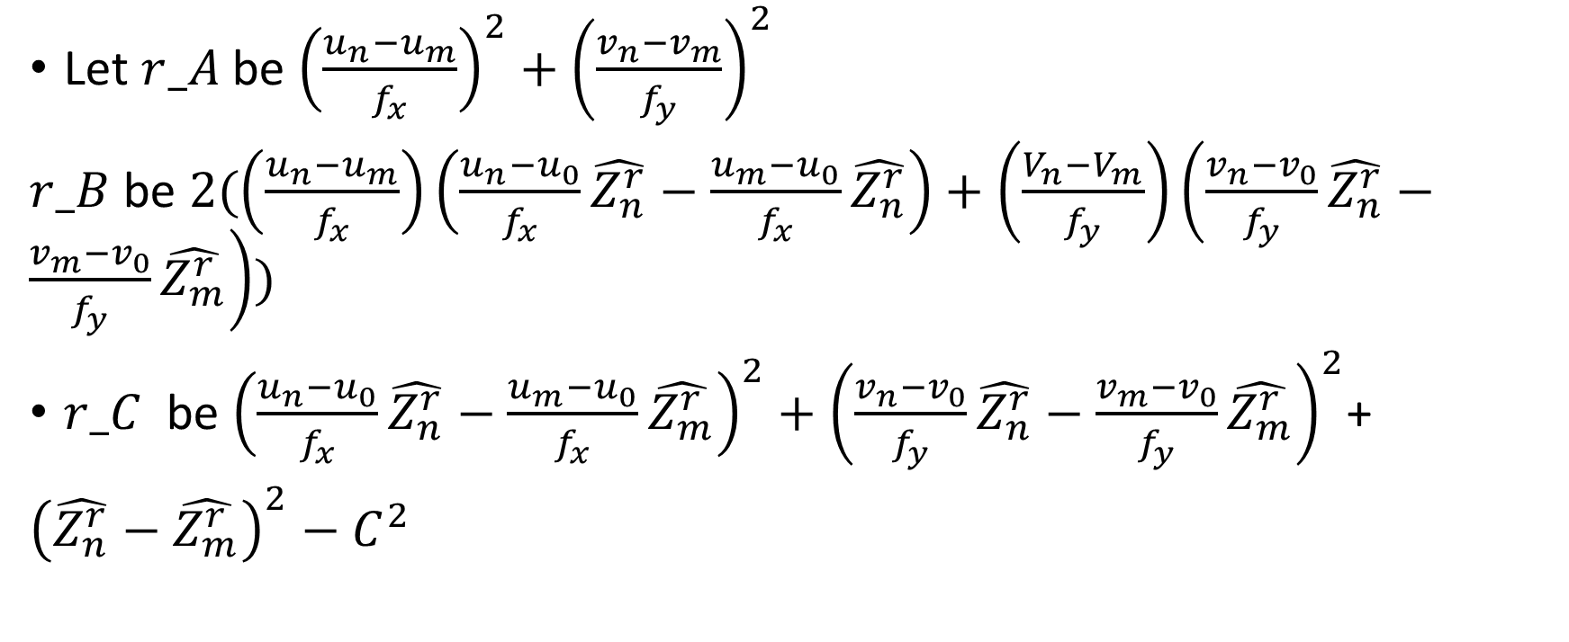
Scale-normalized depth value of root
Let $r_A$ be ${\left(\frac{u_{n}−u_{m}}{f_{x}}\right)}^{2}+{\left(\frac{v_{n}−v_{m}}{f_{y}}\right)}^{2}$
$r_B$ be $2(\left(\frac{u_{n}−u_{m}}{f_{x}}\right)\left(\frac{u_{n}−u_{0}}{f_{x}}\hat{Z_{n}^{r}}−\frac{u_{m}−u_{0}}{f_{x}}\hat{Z_{n}^{r}}\right)+\left(\frac{V_{n}−V_{m}}{f_{y}}\right)\left(\frac{v_{n}−v_{0}}{f_{y}}\hat{Z_{n}^{r}}−\frac{v_{m}−v_{0}}{f_{y}}\hat{Z_{m}^{r}}\right))$
$r_C$ be ${\left(\frac{u_{n}−u_{0}}{f_{x}}\hat{Z_{n}^{r}}−\frac{u_{m}−u_{0}}{f_{x}}\hat{Z_{m}^{r}}\right)}^{2}+{\left(\frac{v_{n}−v_{0}}{f_{y}}\hat{Z_{n}^{r}}−\frac{v_{m}−v_{0}}{f_{y}}\hat{Z_{m}^{r}}\right)}^{2}$+
${\left(\hat{Z_{n}^{r}}−\hat{Z_{m}^{r}}\right)}^{2}−C^{2}$

Slide 17

Scale-normalized depth value of root
Then ${r_A t}^{2}+r_B t+r_C =0$
$$t=\frac{−r_B±\sqrt{{r_B}^{2}−4r_A r_C}}{2r_A}$$
Only one $t$ is valid ($bigger one$)

Slide 18
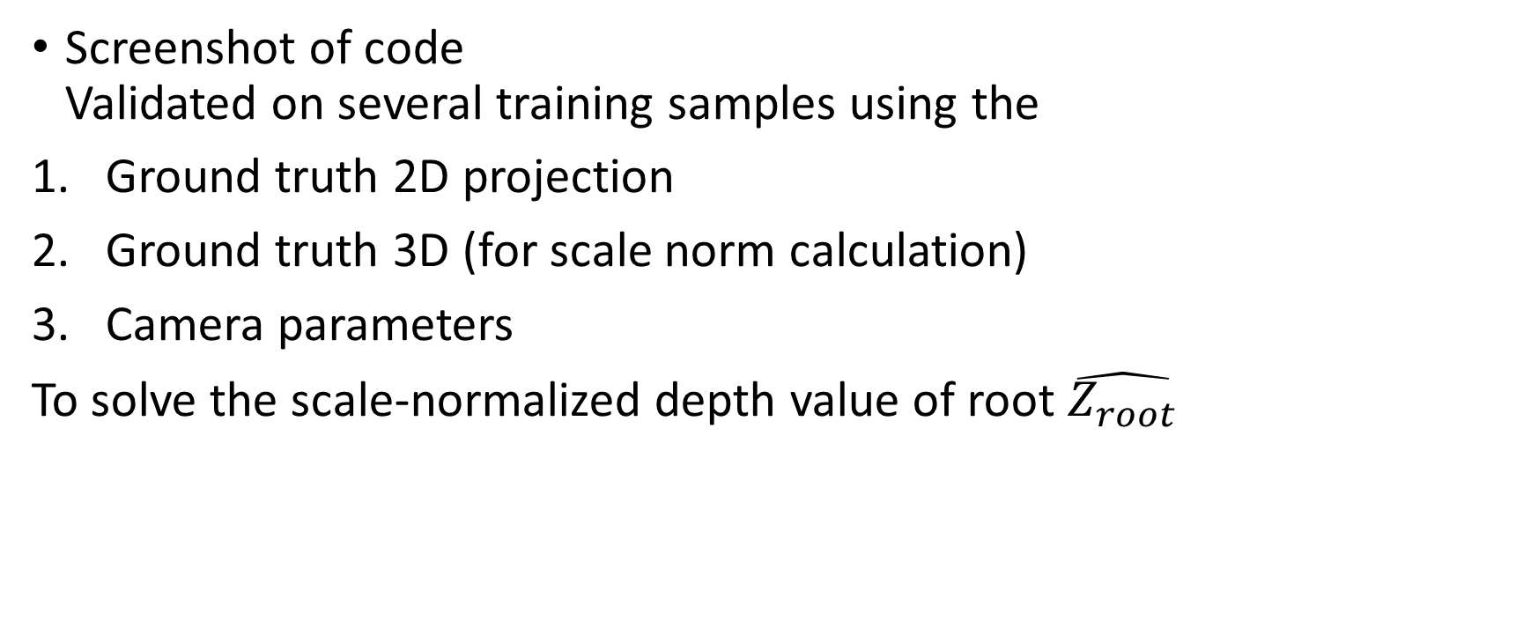
Scale-normalized depth value of root
Screenshot of code Validated on several training samples using the
Ground truth 2D projection
Ground truth 3D (for scale norm calculation)
Camera parameters
To solve the scale-normalized depth value of root $\hat{Z_{root}}$

Slide 19
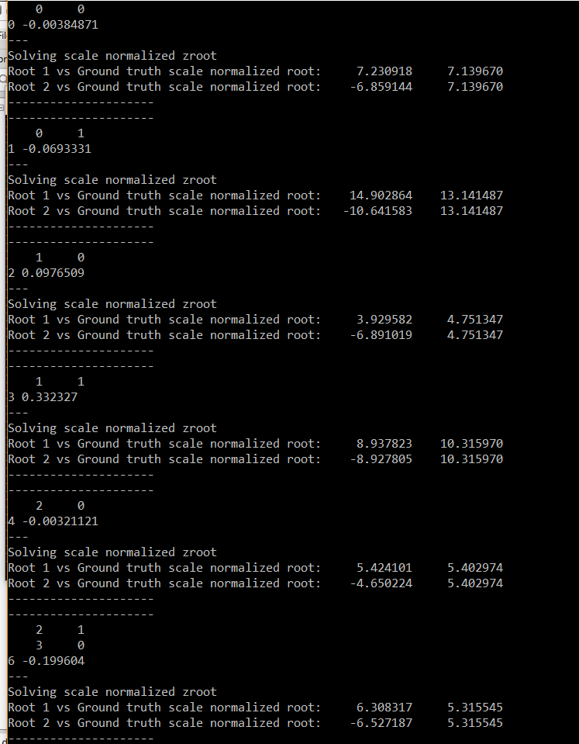
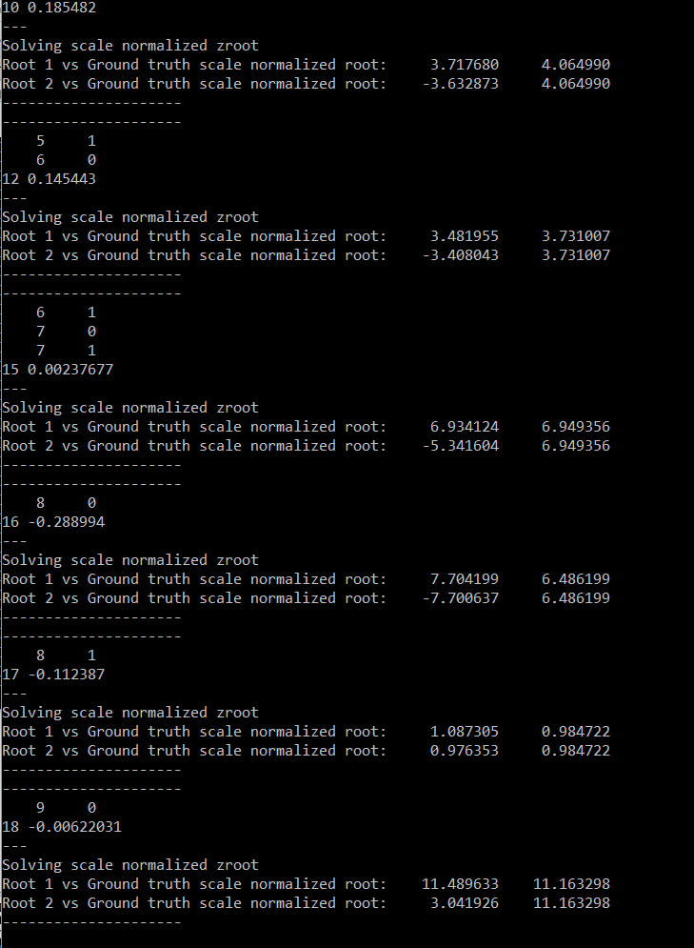
Scale-normalized depth value of root

Slide 20
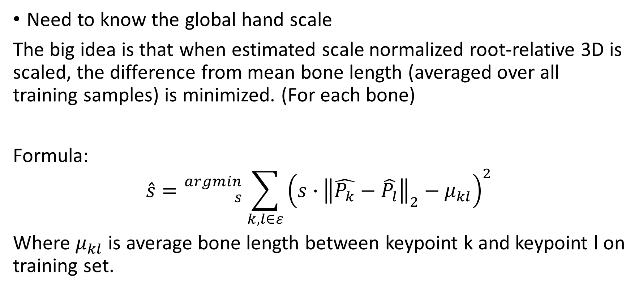
Scale recovery
Need to know the global hand scale
The big idea is that when estimated scale normalized root-relative 3D is scaled, the difference from mean bone length (averaged over all training samples) is minimized. (For each bone)
Formula:
$$\hat{s}={}_{s}^{argmin}{ \sum_{k,l∈ε}{{\left(s∙{\left\|\hat{P_{k}}−\hat{P_{l}}\right\|}_{2}−μ_{kl}\right)}^{2}}}$$
Where $μ_{kl}$ is average bone length between keypoint k and keypoint l on training set.

Slide 21
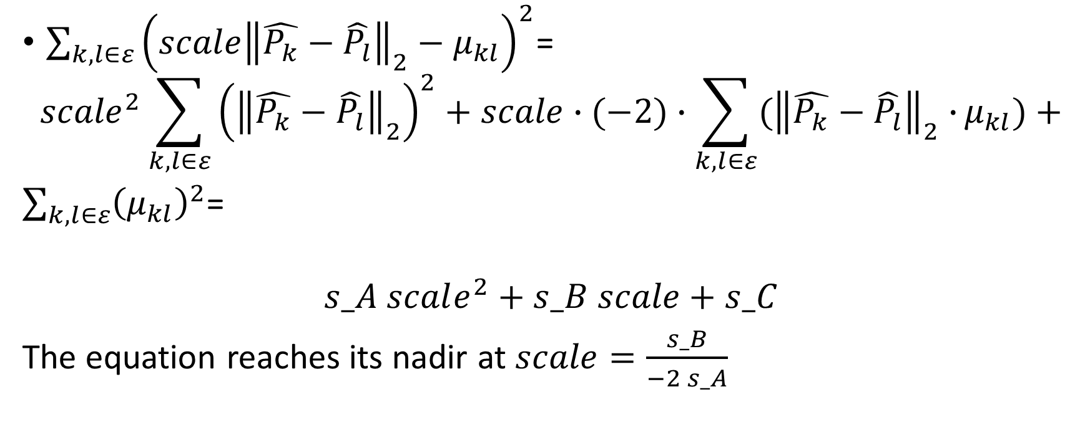
Scale recovery
$\sum_{k,l∈ε}{{\left(scale{\left\|\hat{P_{k}}−\hat{P_{l}}\right\|}_{2}−μ_{kl}\right)}^{2}}$=
$${scale}^{2}\sum_{k,l∈ε}{{\left({\left\|\hat{P_{k}}−\hat{P_{l}}\right\|}_{2}\right)}^{2}}+scale∙(−2)∙\sum_{k,l∈ε}{({\left\|\hat{P_{k}}−\hat{P_{l}}\right\|}_{2}∙}μ_{kl})+$$
$\sum_{k,l∈ε}{{\left(μ_{kl}\right)}^{2}}$=
$$s_A scale^{2}+s_B scale+s_C$$
The equation reaches its nadir at $scale=\frac{s_B}{−2 s_A}$

Slide 22

Scale recovery
Where
$s_A$ $= \sum_{k,l∈ε}{{\left({\left\|\hat{P_{k}}−\hat{P_{l}}\right\|}_{2}\right)}^{2}}$,
$s_B$ $=$ $(−2)∙\sum_{k,l∈ε}{({\left\|\hat{P_{k}}−\hat{P_{l}}\right\|}_{2}∙}μ_{kl}),$
$s_C$ $=\sum_{k,l∈ε}{{\left(μ_{kl}\right)}^{2}}$
Quite elegant!

Slide 23
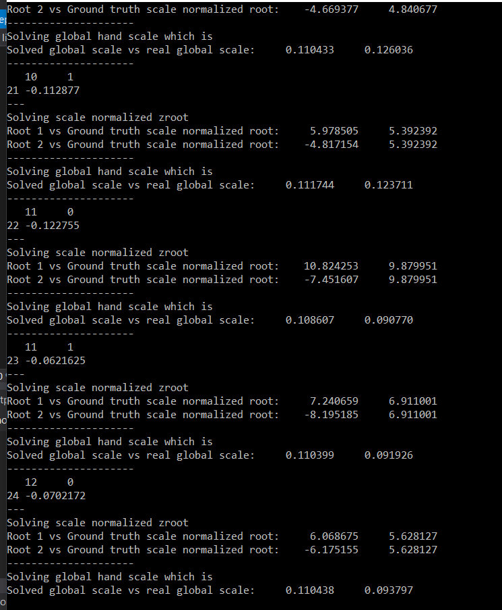
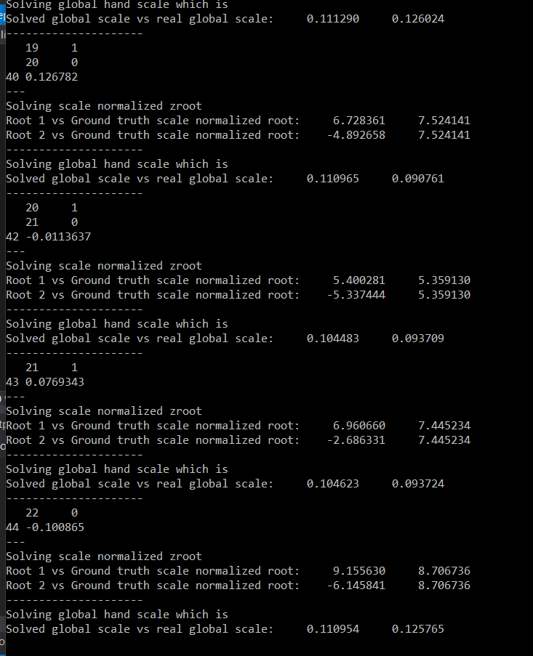
Scale recovery

Slide 24
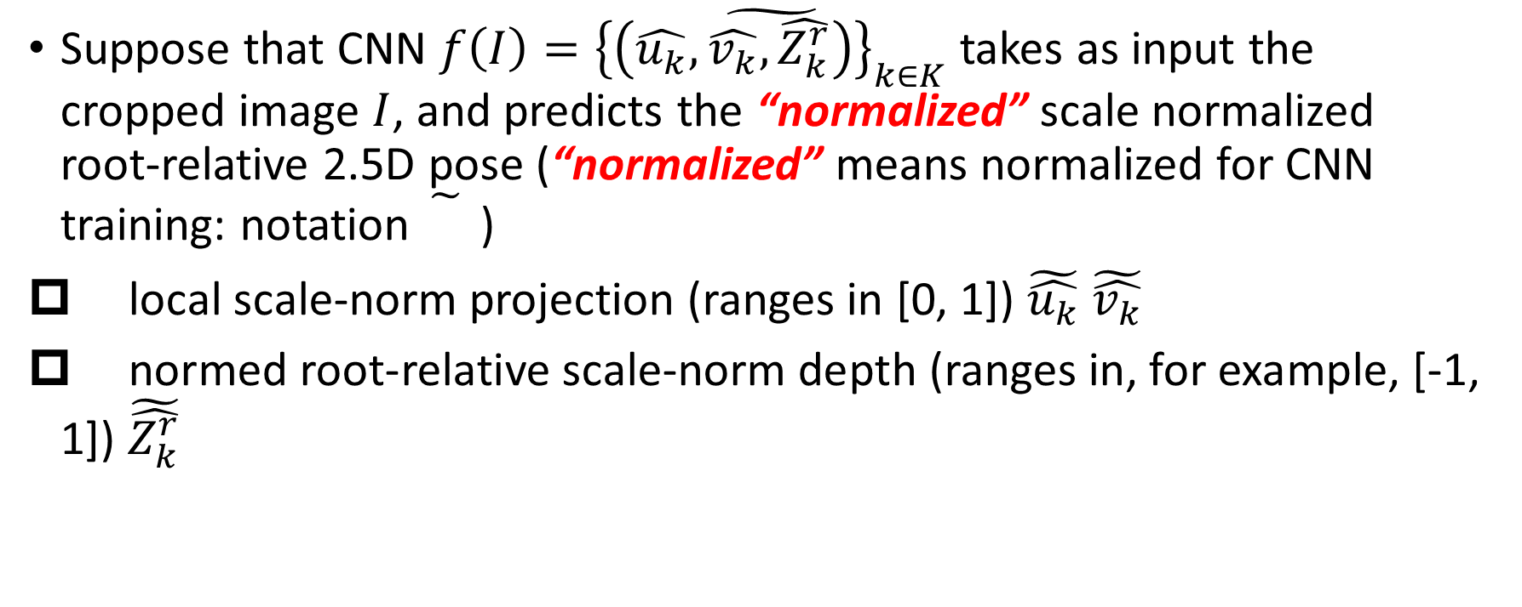
Final step
Suppose that CNN $f\left(I\right)=\tilde{{\left\{\left(\hat{u_{k}},\hat{v_{k}},\hat{Z_{k}^{r}}\right)\right\}}_{k∈K}}$ takes as input the cropped image $I$, and predicts the “normalized” scale normalized root-relative 2.5D pose (“normalized” means normalized for CNN training: notation )
local scale-norm projection (ranges in [0, 1]) $\tilde{\hat{u_{k}}}$ $\tilde{\hat{v_{k}}}$
normed root-relative scale-norm depth (ranges in, for example, [-1, 1]) $\tilde{\hat{Z_{k}^{r}}}$

Slide 25
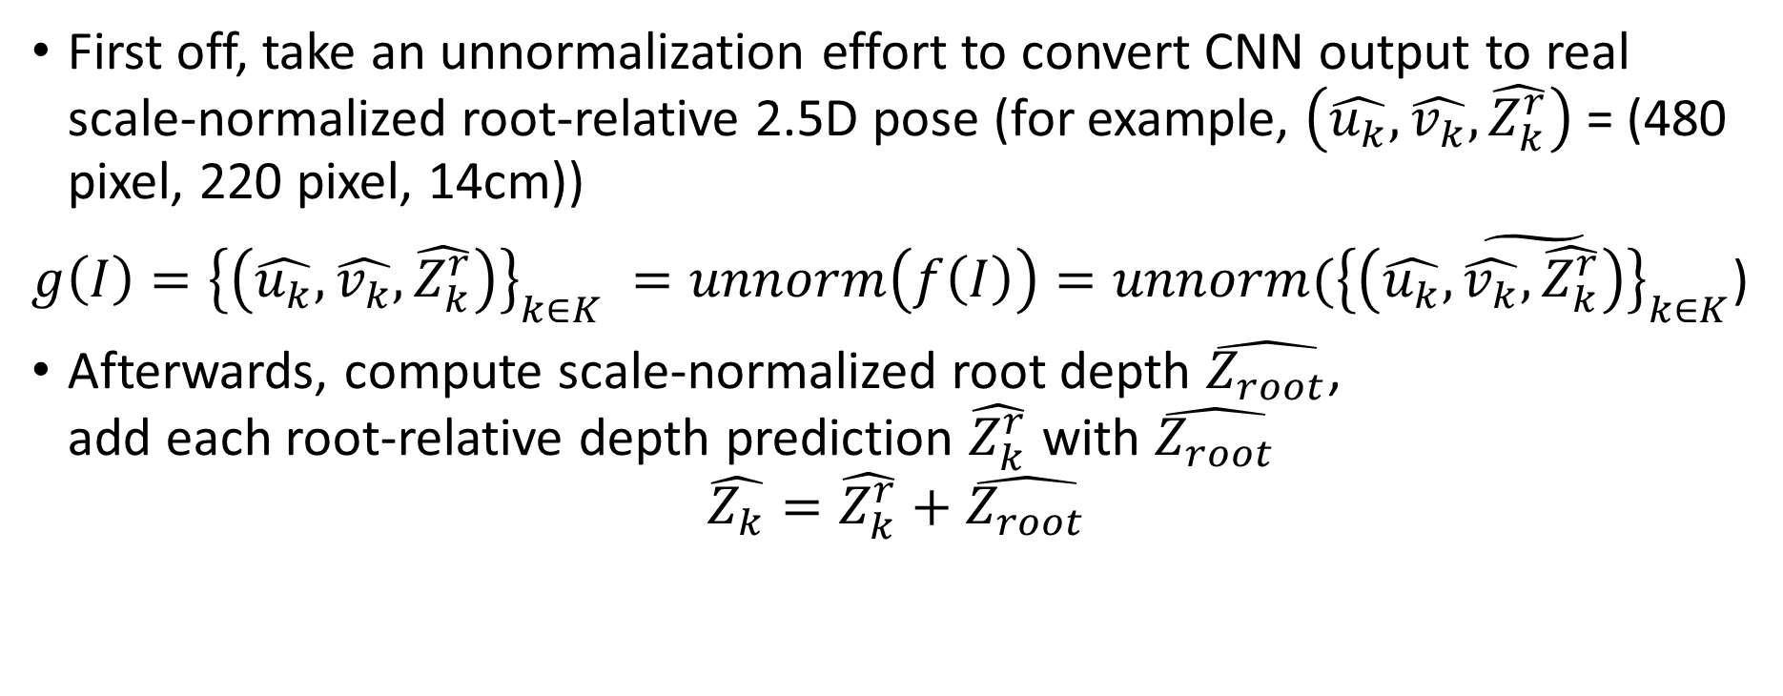
Final step
First off, take an unnormalization effort to convert CNN output to real scale-normalized root-relative 2.5D pose (for example, $\left(\hat{u_{k}},\hat{v_{k}},\hat{Z_{k}^{r}}\right)$ = (480 pixel, 220 pixel, 14cm))
$g\left(I\right)={\left\{\left(\hat{u_{k}},\hat{v_{k}},\hat{Z_{k}^{r}}\right)\right\}}_{k∈K} =unnorm\left(f\left(I\right)\right)=unnorm(\tilde{{\left\{\left(\hat{u_{k}},\hat{v_{k}},\hat{Z_{k}^{r}}\right)\right\}}_{k∈K}}$)
Afterwards, compute scale-normalized root depth $\hat{Z_{root}}$, add each root-relative depth prediction $\hat{Z_{k}^{r}}$ with $\hat{Z_{root}}$
$$\hat{Z_{k}}=\hat{Z_{k}^{r}}+\hat{Z_{root}}$$

Slide 26
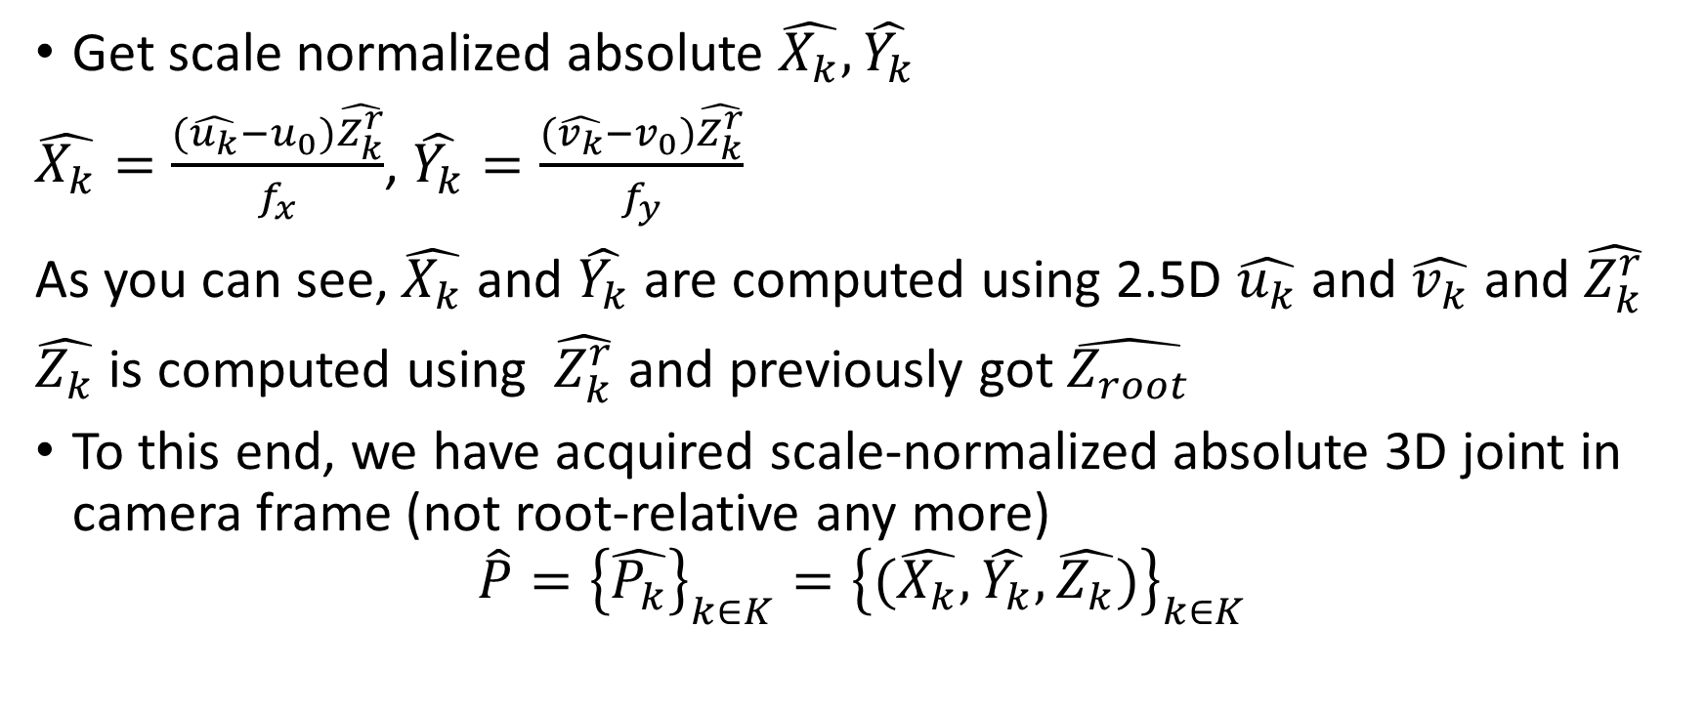
Final step
Get scale normalized absolute $\hat{X_{k}},\hat{Y_{k}}$
$\hat{X_{k}}=\frac{(\hat{u_{k}}−u_{0})\hat{Z_{k}^{r}}}{f_{x}}$, $\hat{Y_{k}}=\frac{(\hat{v_{k}}−v_{0})\hat{Z_{k}^{r}}}{f_{y}}$
As you can see, $\hat{X_{k}}$ and $\hat{Y_{k}}$ are computed using 2.5D $\hat{u_{k}}$ and $\hat{v_{k}}$ and $\hat{Z_{k}^{r}}$
$\hat{Z_{k}}$ is computed using $\hat{Z_{k}^{r}}$ and previously got $\hat{Z_{root}}$
To this end, we have acquired scale-normalized absolute 3D joint in camera frame (not root-relative any more)
$$\hat{P}={\left\{\hat{P_{k}}\right\}}_{k∈K}={\left\{(\hat{X_{k}},\hat{Y_{k}},\hat{Z_{k}})\right\}}_{k∈K}$$

Slide 27
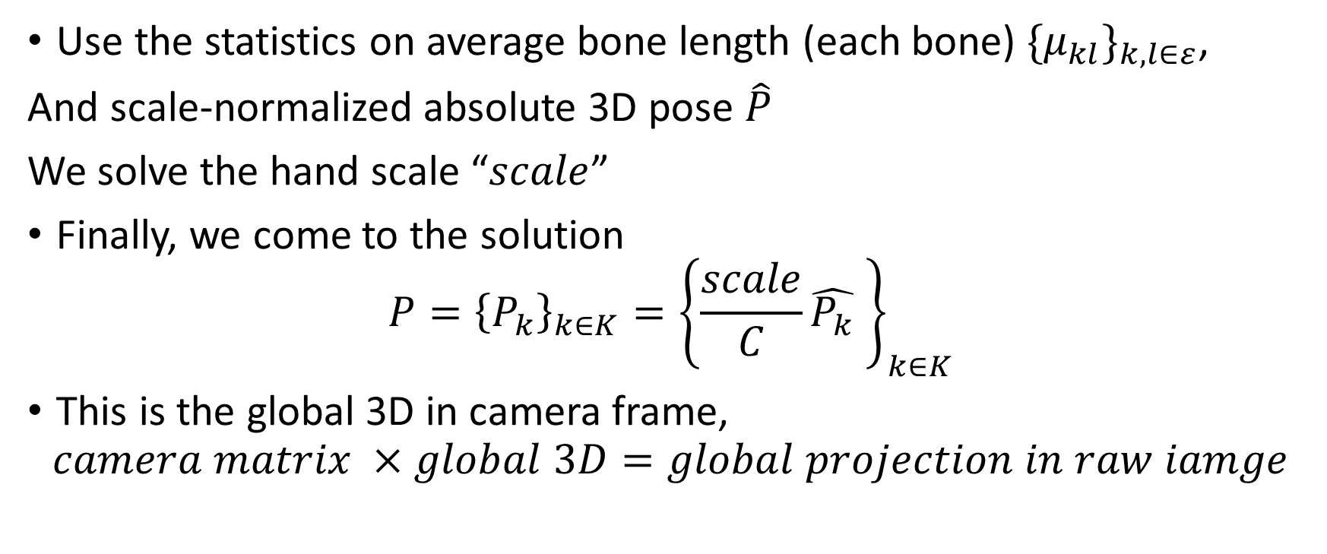
Final step
Use the statistics on average bone length (each bone) ${\{μ_{kl}\}}_{k,l∈ε}$,
And scale-normalized absolute 3D pose $\hat{P}$
We solve the hand scale “$scale$”
Finally, we come to the solution
$$P={\left\{P_{k}\right\}}_{k∈K}={\left\{\frac{scale}{C}\hat{P_{k}} \right\}}_{k∈K}$$
This is the global 3D in camera frame,
$$camera matrix ×global 3D=global projection in raw iamge$$

Slide 28
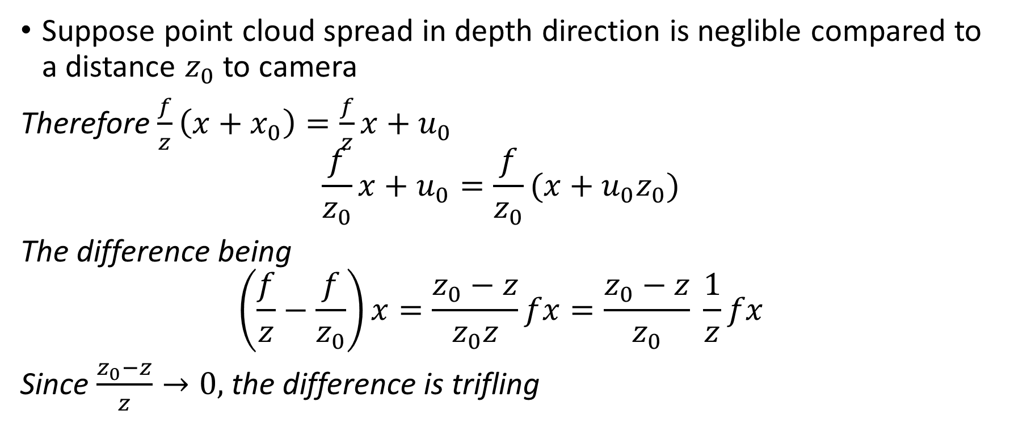
Monocular 3D Human Pose Estimation in the Wild Using Improved CNN Supervision
Suppose point cloud spread in depth direction is neglible compared to a distance $z_{0}$ to camera
Therefore $\frac{f}{z}\left(x+x_{0}\right)=\frac{f}{z}x+u_{0}$ $$\frac{f}{z_{0}}x+u_{0}=\frac{f}{z_{0}}(x+u_{0}z_{0})$$
The difference being $$\left(\frac{f}{z}−\frac{f}{z_{0}}\right)x=\frac{z_{0}−z}{z_{0}z}fx=\frac{z_{0}−z}{z_{0}} \frac{1}{z}fx$$
Since $\frac{z_{0}−z}{z}→0,$ the difference is trifling

Slide 29
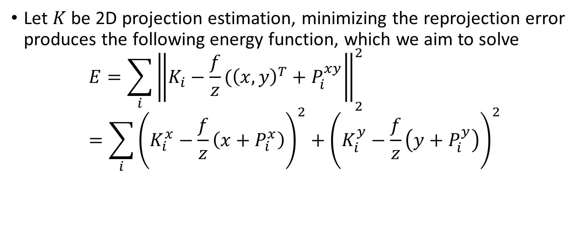
Monocular 3D Human Pose Estimation in the Wild Using Improved CNN Supervision
Let $K$ be 2D projection estimation, minimizing the reprojection error produces the following energy function, which we aim to solve
$$E={\sum_{i}{\left\|K_{i}−\frac{f}{z}({\left(x,y\right)}^{T}+P_{i}^{xy}\right\|}}_{2}^{2}=\sum_{i}{{\left(K_{i}^{x}−\frac{f}{z}\left(x+P_{i}^{x}\right)\right)}^{2}+{\left(K_{i}^{y}−\frac{f}{z}\left(y+P_{i}^{y}\right)\right)}^{2}}$$

Slide 30
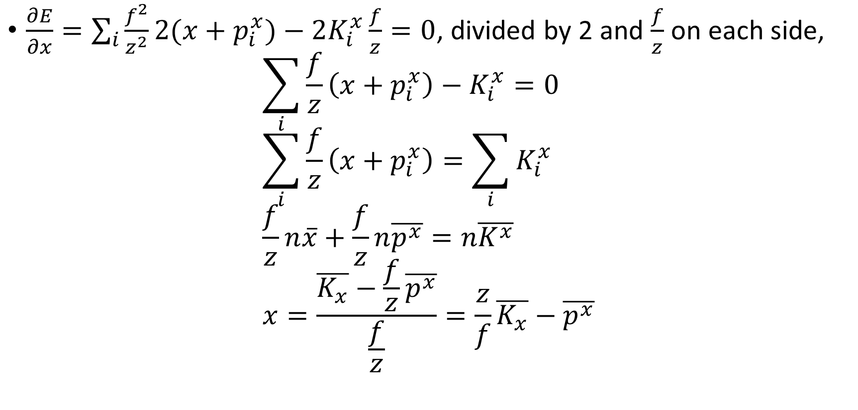
Monocular 3D Human Pose Estimation in the Wild Using Improved CNN Supervision
$\frac{∂E}{∂x}=\sum_{i}{\frac{f^{2}}{z^{2}}2(x+p_{i}^{x})}−2K_{i}^{x}\frac{f}{z}=0$, divided by 2 and $\frac{f}{z}$ on each side,
$$\sum_{i}{\frac{f}{z}\left(x+p_{i}^{x}\right)−K_{i}^{x}}=0 \\ \sum_{i}{\frac{f}{z}\left(x+p_{i}^{x}\right)=\sum_{i}{K_{i}^{x}}} \\ \frac{f}{z}n\overline{x}+\frac{f}{z}n\overline{p^{x}}=n\overline{K^{x}} \\ x=\frac{\overline{K_{x}}−\frac{f}{z}\overline{p^{x}}}{\frac{f}{z}}=\frac{z}{f}\overline{K_{x}}−\overline{p^{x}}$$

Slide 31

Monocular 3D Human Pose Estimation in the Wild Using Improved CNN Supervision
Similarly solve $\frac{∂E}{∂y}=0$
$y=\frac{z}{f}\overline{K_{y}}−\overline{p^{y}}$

Slide 32
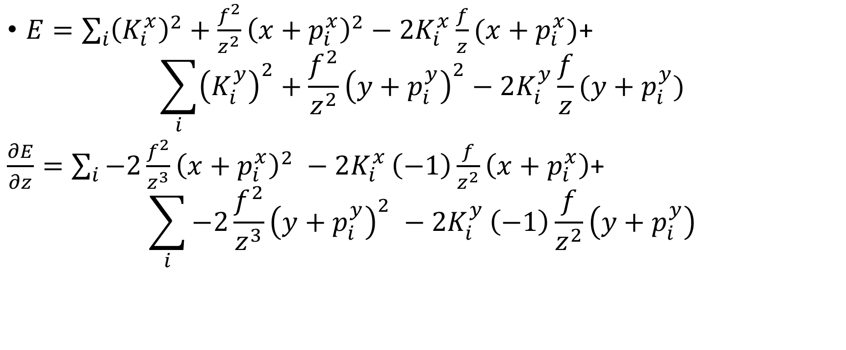
Monocular 3D Human Pose Estimation in the Wild Using Improved CNN Supervision
$E=\sum_{i}{{\left(K_{i}^{x}\right)}^{2}+\frac{f^{2}}{z^{2}}{\left(x+p_{i}^{x}\right)}^{2}−2K_{i}^{x}\frac{f}{z}(x+p_{i}^{x})}$+
$$\sum_{i}{{\left(K_{i}^{y}\right)}^{2}+\frac{f^{2}}{z^{2}}{\left(y+p_{i}^{y}\right)}^{2}−2K_{i}^{y}\frac{f}{z}(y+p_{i}^{y})}$$
$\frac{∂E}{∂z}=\sum_{i}{−2\frac{f^{2}}{z^{3}}{\left(x+p_{i}^{x}\right)}^{2} −2K_{i}^{x}}\left(−1\right)\frac{f}{z^{2}}\left(x+p_{i}^{x}\right)$+
$$\sum_{i}{−2\frac{f^{2}}{z^{3}}{\left(y+p_{i}^{y}\right)}^{2} −2K_{i}^{y}}\left(−1\right)\frac{f}{z^{2}}\left(y+p_{i}^{y}\right)$$

Slide 33
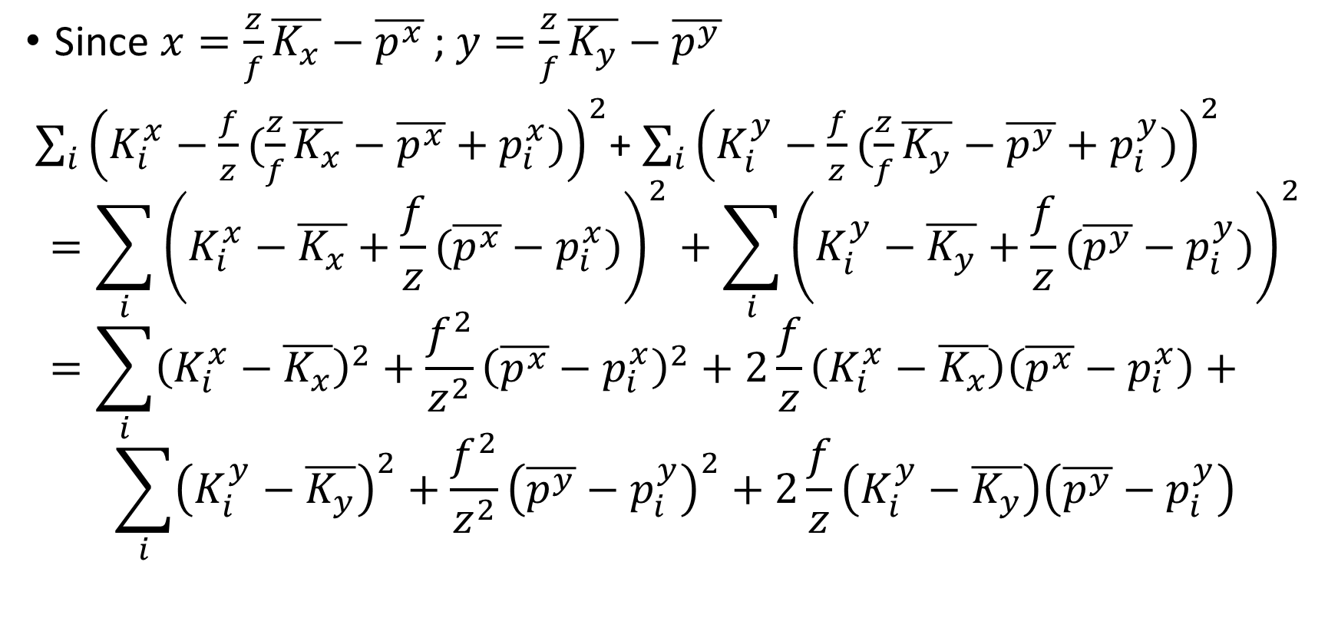
Monocular 3D Human Pose Estimation in the Wild Using Improved CNN Supervision
Since $x=\frac{z}{f}\overline{K_{x}}−\overline{p^{x}}$ ; $y=\frac{z}{f}\overline{K_{y}}−\overline{p^{y}}$
$\sum_{i}{{\left(K_{i}^{x}−\frac{f}{z}(\frac{z}{f}\overline{K_{x}}−\overline{p^{x}}+p_{i}^{x})\right)}^{2}}$+ $\sum_{i}{{\left(K_{i}^{y}−\frac{f}{z}(\frac{z}{f}\overline{K_{y}}−\overline{p^{y}}+p_{i}^{y})\right)}^{2}}$ $$=\sum_{i}{{\left(K_{i}^{x}−\overline{K_{x}}+\frac{f}{z}(\overline{p^{x}}−p_{i}^{x})\right)}^{2}}+\sum_{i}{{\left(K_{i}^{y}−\overline{K_{y}}+\frac{f}{z}(\overline{p^{y}}−p_{i}^{y})\right)}^{2}} \\ =\sum_{i}{{\left(K_{i}^{x}−\overline{K_{x}}\right)}^{2}}+\frac{f^{2}}{z^{2}}{\left(\overline{p^{x}}−p_{i}^{x}\right)}^{2}+2\frac{f}{z}\left(K_{i}^{x}−\overline{K_{x}}\right)\left(\overline{p^{x}}−p_{i}^{x}\right)+$$
$$\sum_{i}{{\left(K_{i}^{y}−\overline{K_{y}}\right)}^{2}}+\frac{f^{2}}{z^{2}}{\left(\overline{p^{y}}−p_{i}^{y}\right)}^{2}+2\frac{f}{z}\left(K_{i}^{y}−\overline{K_{y}}\right)\left(\overline{p^{y}}−p_{i}^{y}\right)$$

Slide 34
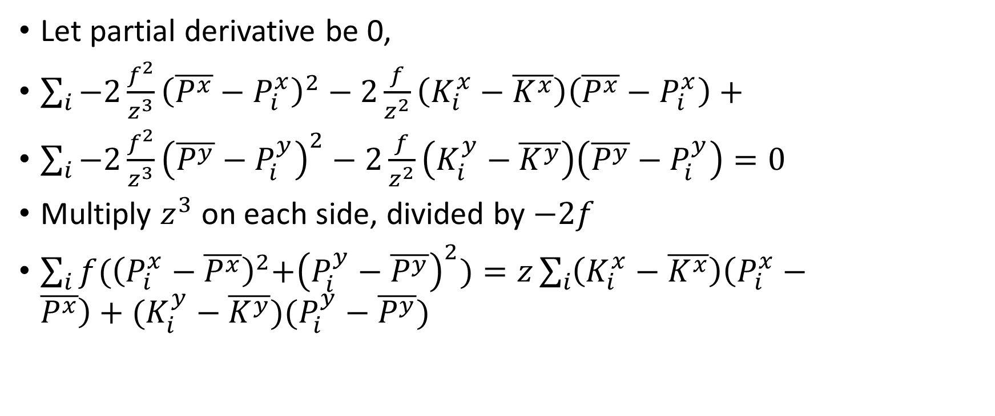
Monocular 3D Human Pose Estimation in the Wild Using Improved CNN Supervision
Let partial derivative be 0,
$\sum_{i}{−2\frac{f^{2}}{z^{3}}{\left(\overline{P^{x}}−P_{i}^{x}\right)}^{2}−2\frac{f}{z^{2}}\left(K_{i}^{x}−\overline{K^{x}}\right)\left(\overline{P^{x}}−P_{i}^{x}\right)+}$
$\sum_{i}{−2\frac{f^{2}}{z^{3}}{\left(\overline{P^{y}}−P_{i}^{y}\right)}^{2}−2\frac{f}{z^{2}}\left(K_{i}^{y}−\overline{K^{y}}\right)\left(\overline{P^{y}}−P_{i}^{y}\right)}=0$
Multiply $z^{3}$ on each side, divided by $−2f$
$\sum_{i}{f{(\left(P_{i}^{x}−\overline{P^{x}}\right)}^{2}+{\left(P_{i}^{y}−\overline{P^{y}}\right)}^{2})=z\sum_{i}{\left(K_{i}^{x}−\overline{K^{x}}\right)\left(P_{i}^{x}−\overline{P^{x}}\right)+(K_{i}^{y}−\overline{K^{y}}}})(P_{i}^{y}−\overline{P^{y}})$

Slide 35

Monocular 3D Human Pose Estimation in the Wild Using Improved CNN Supervision
$z=f\frac{\sum_{i}{{\left\|P_{i}−\overline{P}\right\|}_{2}^{2}}}{\sum_{i}{{\left(K_{i}−\overline{K}\right)}^{T}(}P_{i}−\overline{P})}$
${\left(K_{i}−\overline{K}\right)}^{T}\left(P_{i}−\overline{P}\right)=\left\|K_{i}−\overline{K}\right\|\left\|P_{i}−\overline{P}\right\|\cos\left(θ\right)$
If we assume approximately $θ$ is equal 0

Slide 36
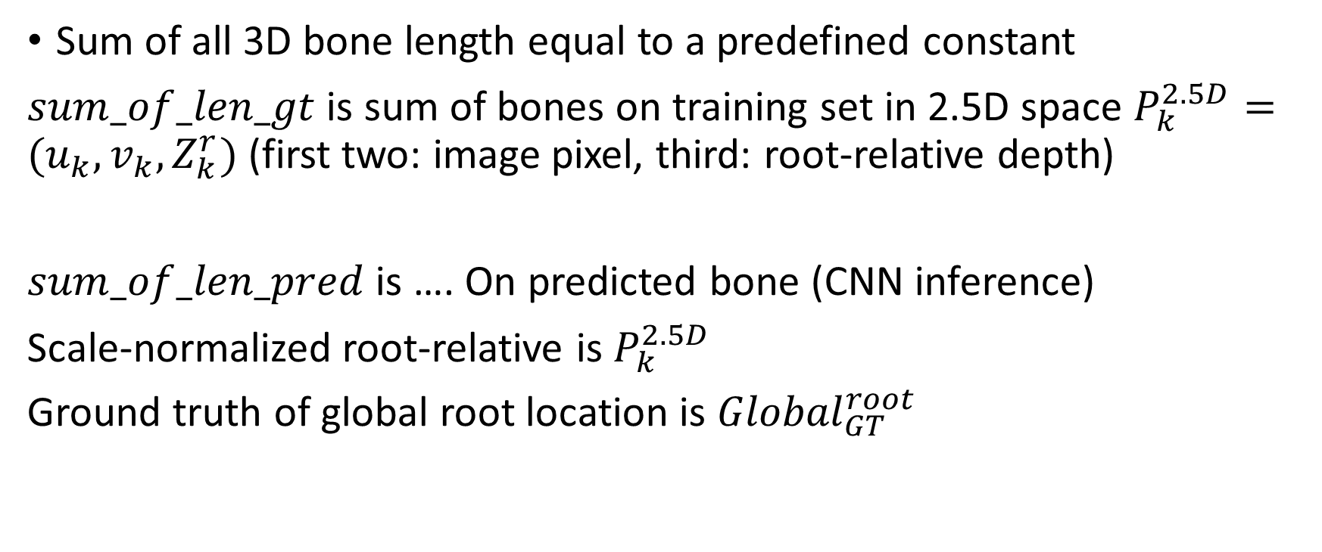
Towards 3D Human Pose Estimation in the Wild: a Weakly-supervised Approach
Sum of all 3D bone length equal to a predefined constant
$sum_of_len_gt$ is sum of bones on training set in 2.5D space $P_{k}^{2.5D}=(u_{k},v_{k},Z_{k}^{r})$ (first two: image pixel, third: root-relative depth)
$sum_of_len_pred$ is …. On predicted bone (CNN inference)
Scale-normalized root-relative is $P_{k}^{2.5D}$
Ground truth of global root location is ${Global}_{GT}^{root}$

Slide 37
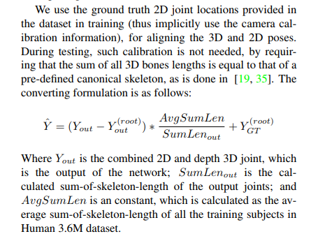
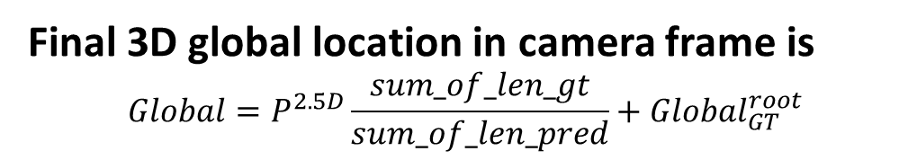
Towards 3D Human Pose Estimation in the Wild: a Weakly-supervised Approach
Final 3D global location in camera frame is
$$Global=P^{2.5D}\frac{sum_of_len_gt}{sum_of_len_pred}+Global_{GT}^{root}$$

Slide 38
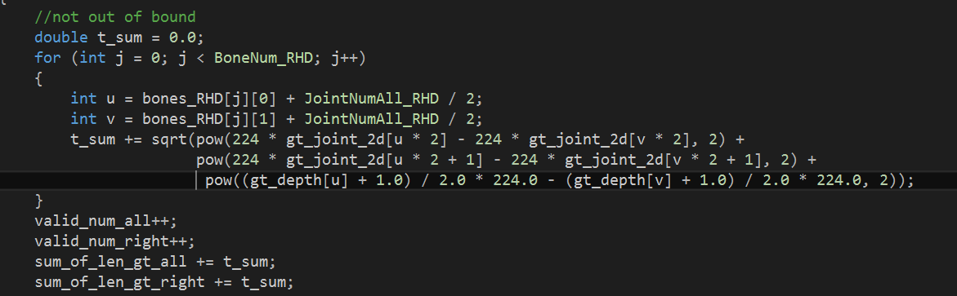

Towards 3D Human Pose Estimation in the Wild: a Weakly-supervised Approach
$sum_of_len_gt$ calculation
1) gt_joint_2d[u * 2] and gt_joint_2d[v * 2] $∈[0 1]$
Image x coordinate of bone $u→v$ , * 2 + 1 : image y coordinate
2) gt_depth[u], gt_depth[v] $∈[−1, 1]$

Slide 39
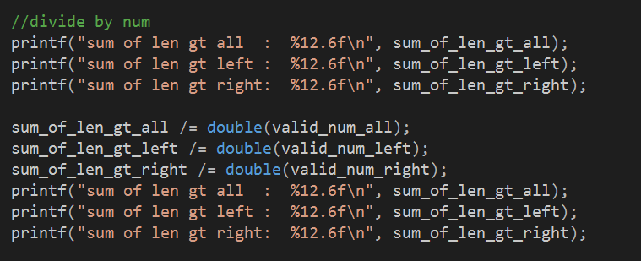
Towards 3D Human Pose Estimation in the Wild: a Weakly-supervised Approach

Slide 40
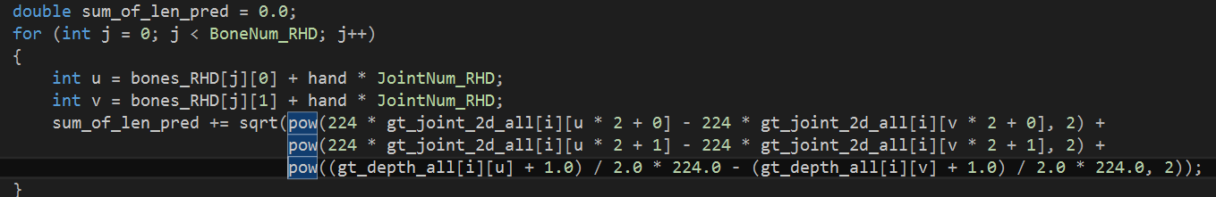

Towards 3D Human Pose Estimation in the Wild: a Weakly-supervised Approach
$sum_of_len_pred$ calculation

Slide 41
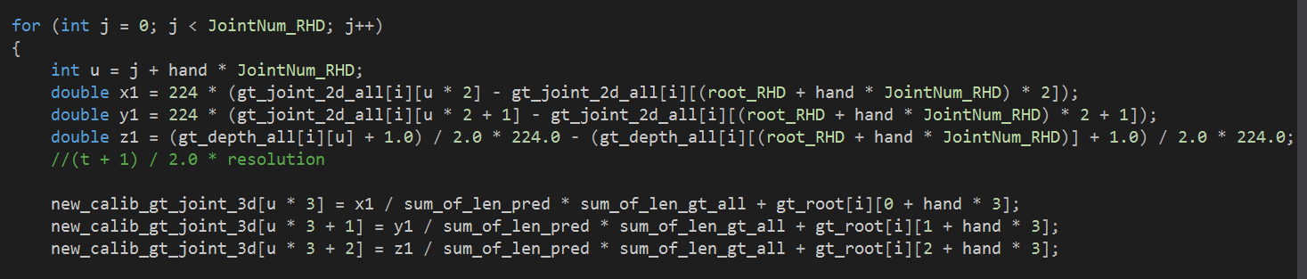
Towards 3D Human Pose Estimation in the Wild: a Weakly-supervised Approach
Calibration from 2.5D space to camera frame global 3D

Slide 42
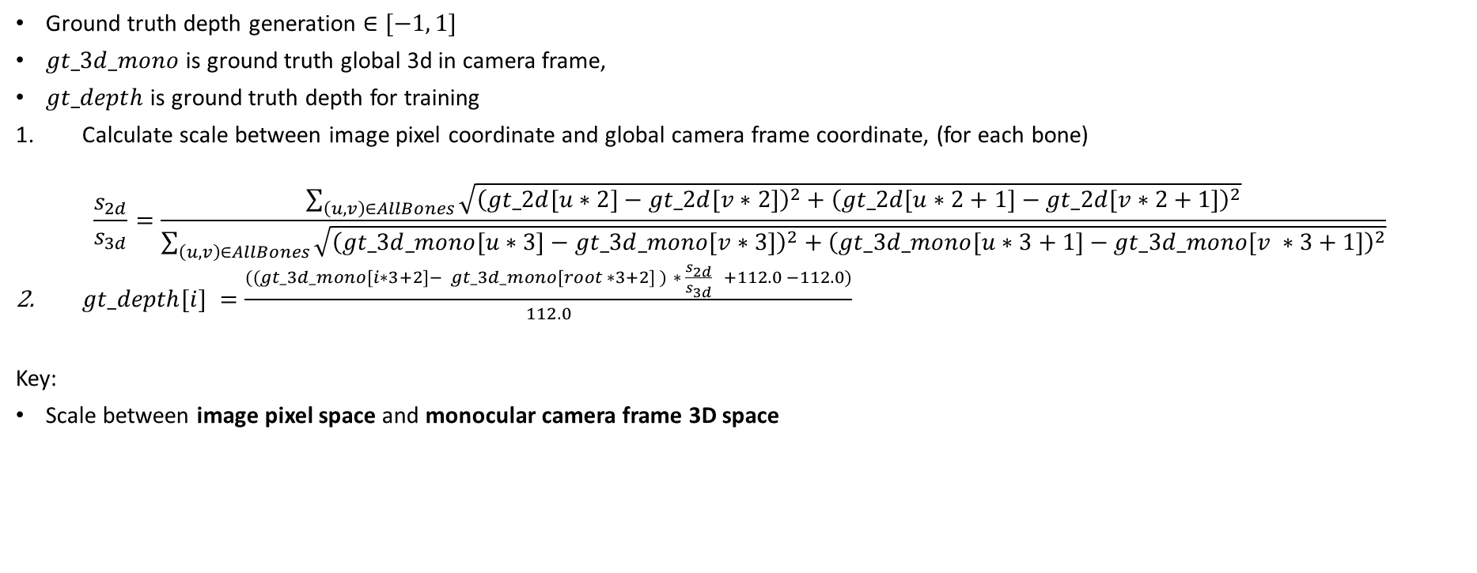
Towards 3D Human Pose Estimation in the Wild: a Weakly-supervised Approach
Ground truth depth generation $∈[−1, 1]$
$gt_3d_mono$ is ground truth global 3d in camera frame,
$gt_depth$ is ground truth depth for training
Calculate scale between image pixel coordinate and global camera frame coordinate, (for each bone)
$$\frac{s_{2d}}{s_{3d}}=\frac{\sum_{\left(u,v\right)∈AllBones}{\sqrt{{\left(gt_2d[u∗2]−gt_2d[v∗2]\right)}^{2}+{\left(gt_2d[u∗2+1]−gt_2d[v∗2+1]\right)}^{2}}}}{\sum_{\left(u,v\right)∈AllBones}{\sqrt{{\left(gt_3d_mono[u∗3]−gt_3d_mono[v∗3]\right)}^{2}+{\left(gt_3d_mono[u∗3+1]−gt_3d_mono[v ∗3+1]\right)}^{2}}}}$$
$gt_depth[i] =\frac{((gt_3d_mono[i∗3+2]− gt_3d_mono[root ∗3+2] ) ∗ \frac{s_{2d}}{s_{3d}} +112.0 −112.0)}{112.0}$
Key:
Scale between image pixel space and monocular camera frame 3D space

Slide 43
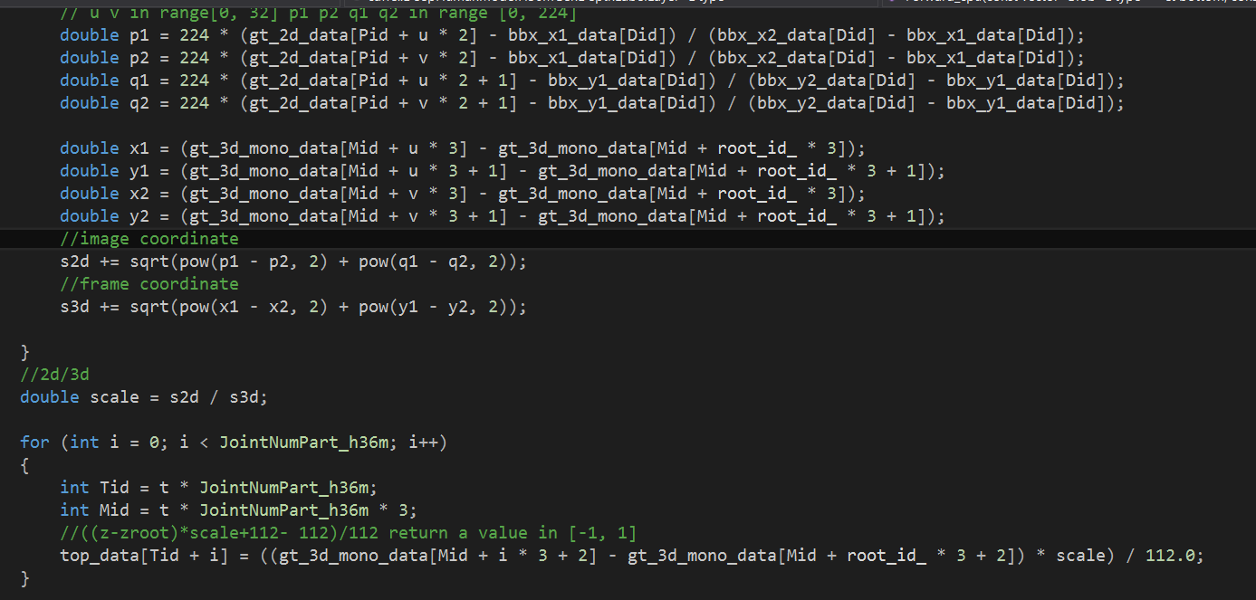
Towards 3D Human Pose Estimation in the Wild: a Weakly-supervised Approach

Slide 44
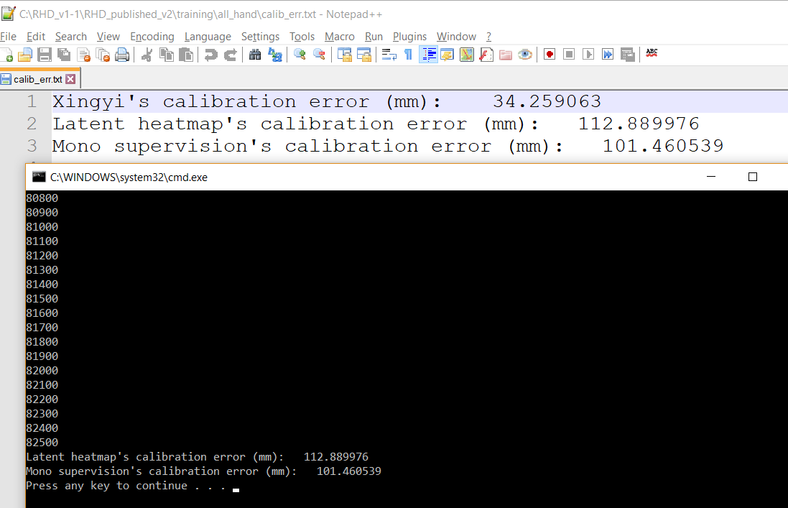

Comparison of three calibrations
Average calibrated joint error in global camera frame space (unit: $mm$)
Screenshot:

